Slide 1
2-Bit Magnitude Comparator
(A>B, A=B, A<B)
DIGITAL LOGIC DESIGN PROJECT
> = <
Design and Simulation using Combinational Logic
Simulated in Verilog • Version-controlled on GitHub
Notes:
Introduce the project: a 2-bit magnitude comparator compares two 2-bit unsigned numbers A (A1A0) and B (B1B0) and drives three outputs: A greater than B, A equal to B, A less than B. Exactly one output is high for every input pair.

Slide 2




Why Do We Need a Magnitude Comparator?
PROBLEM STATEMENT
What the circuit must solve
Applications
Digital systems often need to know whether one binary number is greater than, equal to, or less than another.
ALU and CPU
Sorting, arbiters
Doing this in software needs a processor and adds latency for what is a simple, fixed logic rule.
The circuit must compare A[1:0] and B[1:0] for all 16 input pairs and assert exactly one of A>B, A=B, A<B.
Control systems
Cache, memory
It should use minimum logic: two XNOR gates plus a few AND, OR and NOR gates.
Goal: one-hot output, no software needed
Notes:
State the problem: compare two 2-bit unsigned numbers and raise exactly one of three outputs. Mention why hardware beats software for this fixed rule. Applications: ALUs use comparators for conditional branches, sorting networks and arbiters pick the larger value, control systems compare a reading to a set-point, caches compare address tags.

Slide 3
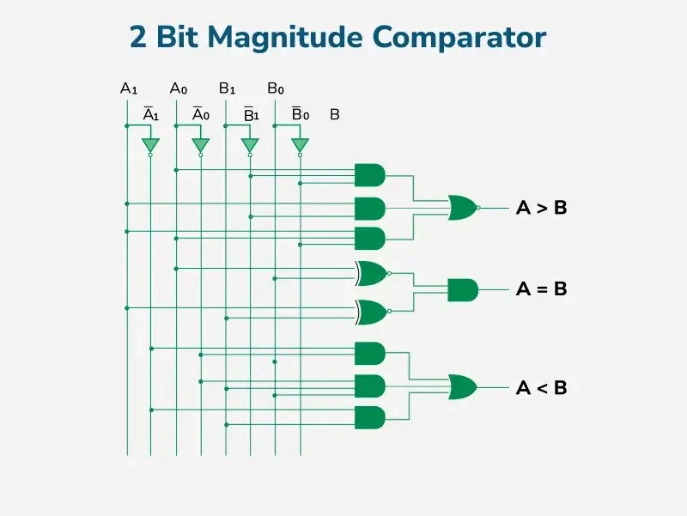
From Truth Table to Gate-Level Circuit
DESIGN & METHODOLOGY
Truth Table
Gate-Level Circuit
A1 | A0 | B1 | B0 | A>B | A=B | A<B
0 | 0 | 0 | 0 | 0 | 1 | 0
0 | 0 | 0 | 1 | 0 | 0 | 1
0 | 0 | 1 | 0 | 0 | 0 | 1
0 | 0 | 1 | 1 | 0 | 0 | 1
0 | 1 | 0 | 0 | 1 | 0 | 0
0 | 1 | 0 | 1 | 0 | 1 | 0
0 | 1 | 1 | 0 | 0 | 0 | 1
0 | 1 | 1 | 1 | 0 | 0 | 1
1 | 0 | 0 | 0 | 1 | 0 | 0
1 | 0 | 0 | 1 | 1 | 0 | 0
1 | 0 | 1 | 0 | 0 | 1 | 0
1 | 0 | 1 | 1 | 0 | 0 | 1
1 | 1 | 0 | 0 | 1 | 0 | 0
1 | 1 | 0 | 1 | 1 | 0 | 0
1 | 1 | 1 | 0 | 1 | 0 | 0
1 | 1 | 1 | 1 | 0 | 1 | 0
(A = B) = (x1 AND X0)
(A>B) = (A1 AND NOT B1) 0R ( X1 AND A0 AND NOT B0)
(A<B) = ( NOT A1 AND B1) 0R ( X1 AND NOT A0 AND B0)
GATES USED : AND,OR,NOT
Notes:
Left: the 16-row truth table, with the active output highlighted. Right: the gate-level circuit. Two XNOR gates give per-bit equality x1 and x0. A=B is x1 AND x0. A>B is true when the MSB of A is 1 and of B is 0, or the MSBs match and A0>B0. A<B is NOR of the other two because the outputs are one-hot.

Slide 4
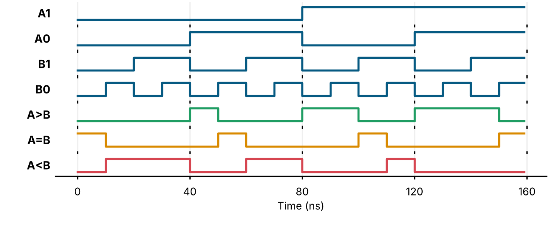
Simulating the Circuit in Verilog
SIMULATION & DEMO
1
2
3
4
Write the Design
Write the Testbench
Run the Simulation
Read the Results
Code comparator_2bit.v with the XNOR, AND, OR and NOR gate equations.
Step A and B through all 16 combinations, 10 ns apart, and self-check.
Compile with iverilog, run vvp, then open the .vcd file in GTKWave.
Exactly one of A>B, A=B, A<B is high for every input pair.
Demo artefact:
Verilog design and self-checking testbench, with the truth table and waveform for all 16 input pairs.
16/16
10 ns
test cases pass
per input pair
Notes:
Walk through the four steps. The demo artefact is the design, the testbench, the truth table and the waveform. In the waveform each 10 ns the inputs step to the next A,B pair and exactly one of the three outputs is high. The 16/16 result in this deck comes from a bit-accurate model of the same gate equations; run tb_comparator_2bit.v in Icarus Verilog, Vivado or EDA Playground to reproduce it on the Verilog itself.

Slide 5
Project on GitHub
GITHUB REPOSITORY
2bit-magnitude-comparator /
Conclusion
|--KLH—FED—2026—Session-10-Batch-10
|-- README.md
|--2bit-magnitude-comparator presentation pptx
|--2bit magnitude-comparator.
Two XNOR gates plus a few AND, OR and NOR gates give a one-hot A>B, A=B, A<B result with no software. It was verified for all 16 input pairs and published on GitHub. The same MSB-first idea cascades to wider words.
Truth Table
Gate Design
Verilog
GitHub
Thank You
Notes:
Repository contents. Replace <your-username> with your GitHub username after pushing the project folder. Run: iverilog -o sim comparator_2bit.v tb_comparator_2bit.v, then vvp sim, then gtkwave comparator_2bit.vcd.

